Slide 1

Web Development & Design Foundations with HTML5
Tenth Edition
Chapter 7
Responsive Page Layout
Copyright © 2021, 2019, 2017 Pearson Education, Inc. All Rights Reserved

Slide 2
Learning Outcomes (1 of 2)
In this chapter, you will learn how to ...
Describe CSS Flexible Box Layout
Configure Flexbox Container and Flexbox Items
Create a web page that applies CSS Flexible Box Layout
Describe CSS Grid Layout
Configure a Grid Container
Create responsive page layouts with CSS Grid Layout

Slide 3
Learning Outcomes (2 of 2)
Configure web pages for mobile display using the viewport meta tag
Apply responsive web design techniques with CSS media queries, CSS feature queries, and flexible images
Apply responsive image techniques including the HTML5 picture element

Slide 4
CSS Flexible Box Layout aka flexbox (1 of 2)
Purpose: Provide for a flexible, responsive layout https://www.w3.org/TR/css-flexbox-1/
Best used for one dimension – a row or a column
The display property configures a flexbox container display: flex;
Flex Item – a child element of the flex container
The flex-wrap property
Determines whether flex items are displayed on multiple lines

Slide 5
CSS Flexible Box Layout aka flexbox (2 of 2)
Values are nowrap (default), wrap, wrap-reverse
The flex-direction property
Configures the flow direction
Values are row (default), column, row-reverse, and column-reverse

Slide 6
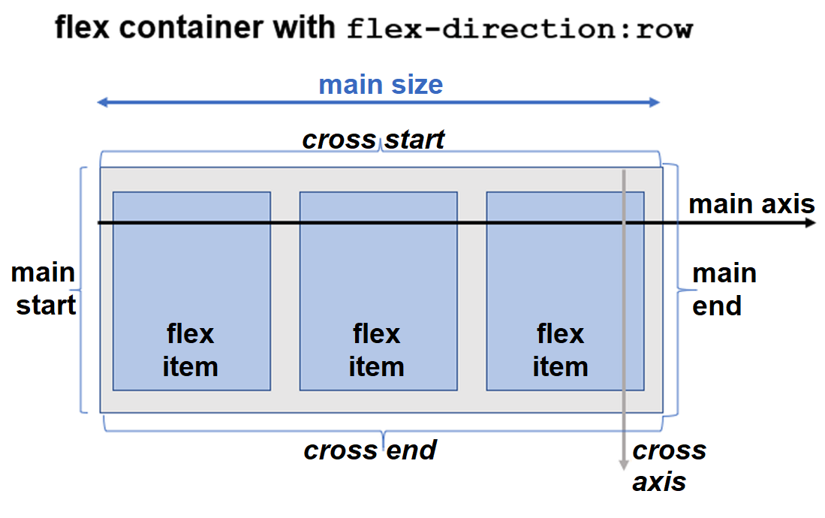
Diagram of a Flex Container (1 of 2)
Figure 7.3 Horizontal flow direction

Slide 7
Diagram of a Flex Container (2 of 2)
Figure 7.4 Vertical flow direction

Slide 8
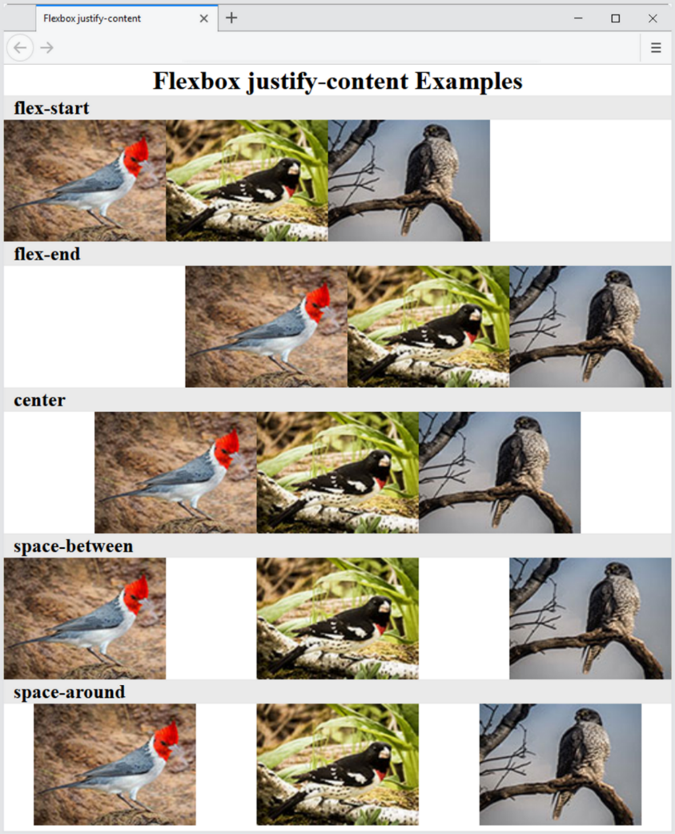
The justify-content Property
Configures how the extra space along the main axis should be displayed
Figure 7.5 The justify-content property

Slide 9
More flexbox Properties
The align-items Property
Configures how the browser displays extra space along the cross-axis
The flex-flow Property
Shorthand to configure flex-direction and flex-wrap properties
The order Property
Causes the browser to display flex items in different order than they are coded
Warning – this could be an accessibility issue

Slide 10
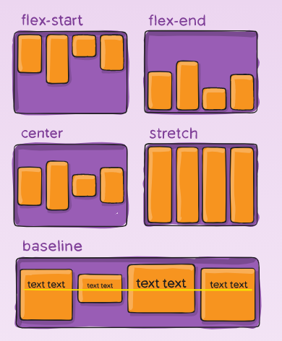
The align-items Property

Slide 11
Configure Flex Items
By default flex items are flexible in size and allocated the same amount of space in the flex container
The flex property
Customizes the size of each flex item
Indicates the flex grow factor
Indicates the flex shrink factor
Can be used to indicate a proportional flexible item

Slide 12
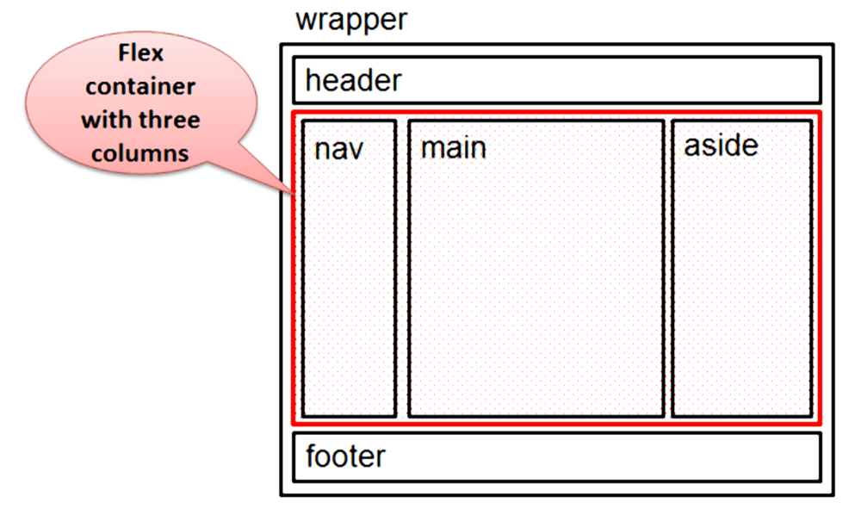
Figure 7.10 Three-column page layout with the flex container indicated
nav { flex: 1; }
main { flex: 7; }
aside { flex: 2; }

Slide 13
CSS Grid Layout (1 of 2)
Purpose: Configure a two-dimensional grid-based layout The grid can be fixed in dimension or flexible and responsive. https://www.w3.org/TR/css-grid-1/
The display property
Configures a grid container display: grid;

Slide 14
CSS Grid Layout (2 of 2)
Grid Item – a child element of the grid container
Grid Terms
Grid line
Grid row
Grid column
Grid track
Grid gap

Slide 15
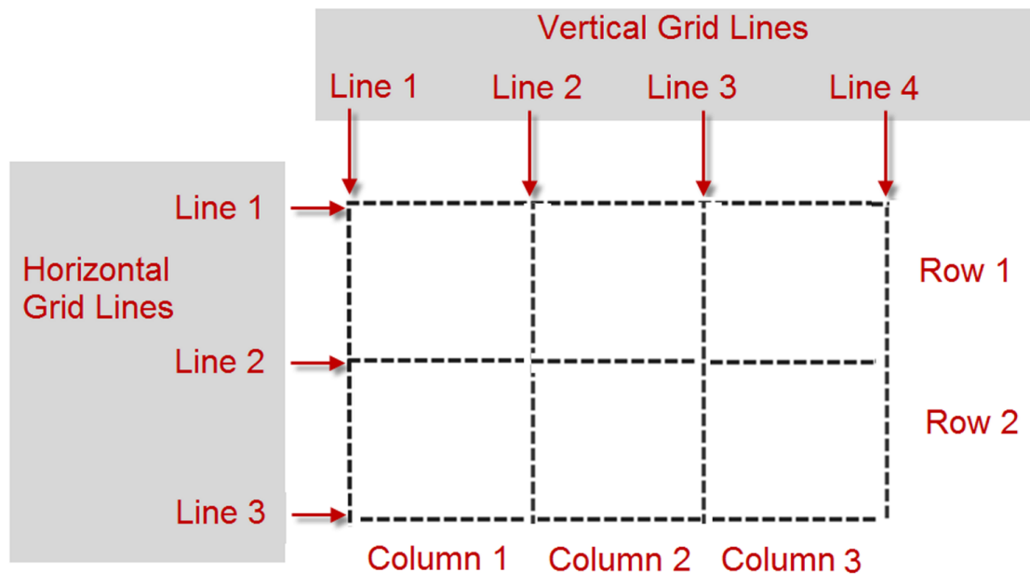
Figure 7.14 A grid with three columns and two rows

Slide 16
Configure Grid Columns and Grid Rows
The grid-template-columns property
The grid-template-rows property
Example:
#gallery { display: grid;
grid-template-columns: 220px 220px 220px;
grid-template-rows: 170px 170px; }

Slide 17
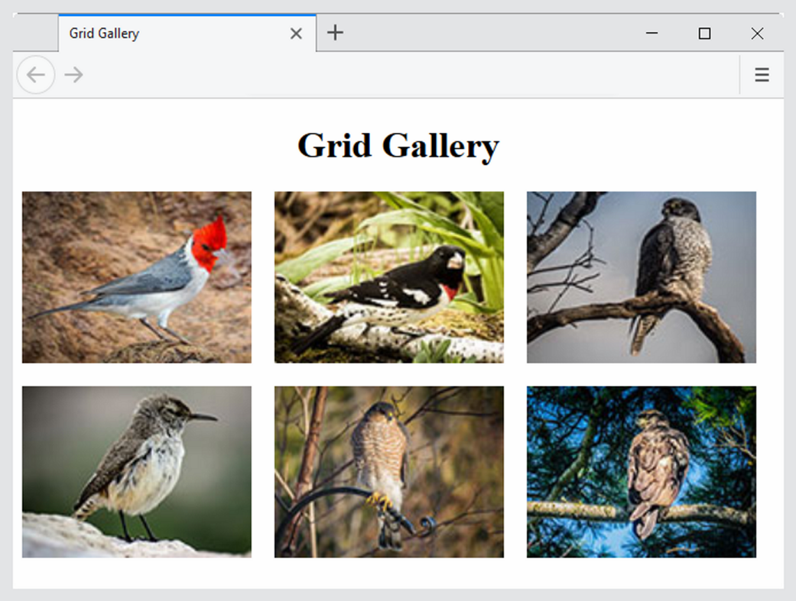
Figure 7.15 A Basic Grid

Slide 18
Grid Columns & Grid Rows
https://www.w3.org/TR/css-grid-1/#propdef-grid-template-columns
Commonly used values for grid-template-columns and grid-template-rows

Slide 19
Table 7.4 Commonly Used Values to Configure Columns and Rows
Value | Description
numeric length unit | Configures a fixed size with a length unit such as px or em Example: 220px
numeric percentage | Configures a percentage size; Example: 20%
numeric fr unit | Configures a flex factor unit (denoted by fr) that directs the browser to allocate a fractional part of the remaining space
auto | Configures a size to hold the maximum content
minmax (min, max) | Configures a size range greater or equal to min value and less than or equal to max value. The max can be set to a flex factor.
repeat(repetition amount, format value) | Repeats the column or row the number of times specified by the repetition amount numeric value or keyword and uses the format value to configure the column or row. The auto-fill keyword indicates to repeat but stop before an overflow. Example: repeat (autofill, 250px)

Slide 20
Configure Grid Items
The grid-row property
configures the area in rows that is reserved for the item in the grid
The grid-column property
configures the area in columns that is reserved for the item in the grid

Slide 21
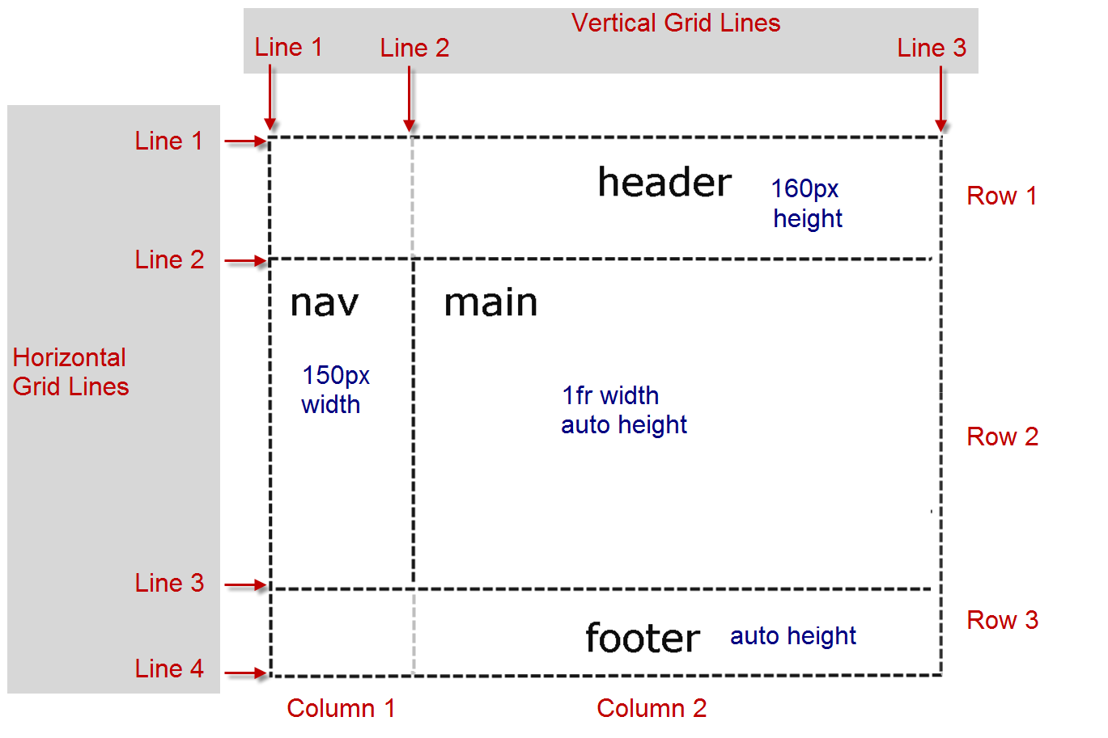
Figure 7.18 Two-column CSS Grid Layout

Slide 22
Configure Line Numbers (1 of 2)
Grid Line Numbers
Identify the starting and ending line number separated by a / character

Slide 23
Configure Line Numbers (2 of 2)
header { grid-row: 1 / 2; grid-column: 1 / 3; }
nav { grid-row: 2 / 3; grid-column: 1 / 2; }
main { grid-row: 2 / 3; grid-column: 2 / 3; }
footer { grid-row: 3 / 4; grid-column: 1 / 3; }
https://www.w3.org/TR/css-grid-1/#typedef-grid-row-start-grid-line

Slide 24
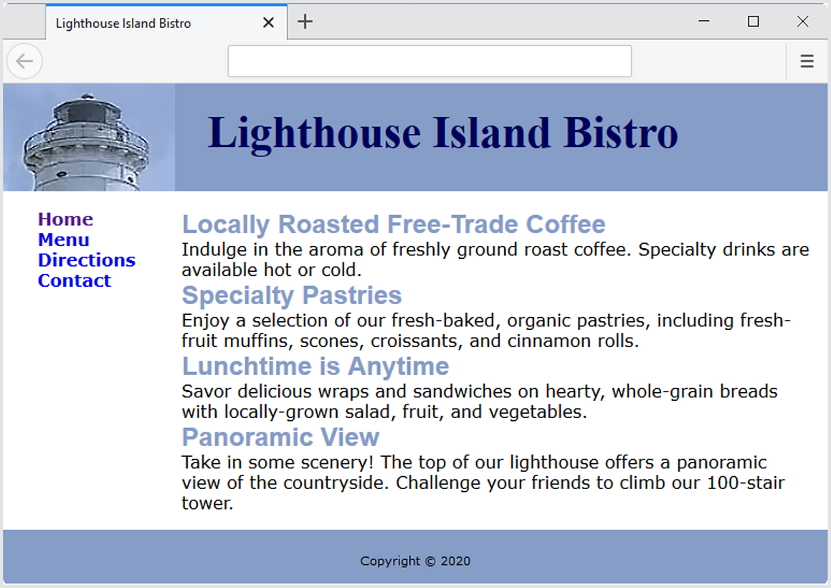
Figure 7.19 Web page with CSS Grid Layout

Slide 25
Configure Grid Areas (1) (1 of 2)
grid-area Property
header { grid-area: header; }
nav { grid-area: nav; }
main { grid-area: main; }
footer { grid-area: footer; }
Figure 7.21 A grid wireframe

Slide 26
Configure Grid Areas (1) (2 of 2)
grid-template-areas Property
#wrapper { display: grid;
grid-template-columns: 150px 1fr;
grid-template-rows: 100px auto 50px;
grid-template-areas:
"header header"
"nav main"
"footer footer"; }
https://www.w3.org/TR/css-grid-1/#grid-template-areas-property

Slide 27
Configure Grid Areas (2)
grid-template Property
#wrapper { display: grid;
grid-template:
"header header header" 100px
"nav main aside " auto
"footer footer footer" 50px
/ 150px 1fr 30%;
https://www.w3.org/TR/css-grid-1/#propdef-grid-template

Slide 28
Checkpoint (1 of 2)
Which CSS property is used to identify a CSS selector as a grid or flexbox container?
The CSS justify-content property used in flexbox layout is quite versatile.
Which CSS property can be used to indicate the location and dimensions of named grid areas?

Slide 29
Center with Flexbox
header { display: flex;
min-height: 100vh;
justify-content: center;
align-items: center;
background-color: #227093;
background-image: url(lake.jpg);
background-size: 100% 100%;
background-repeat: no-repeat; }

Slide 30
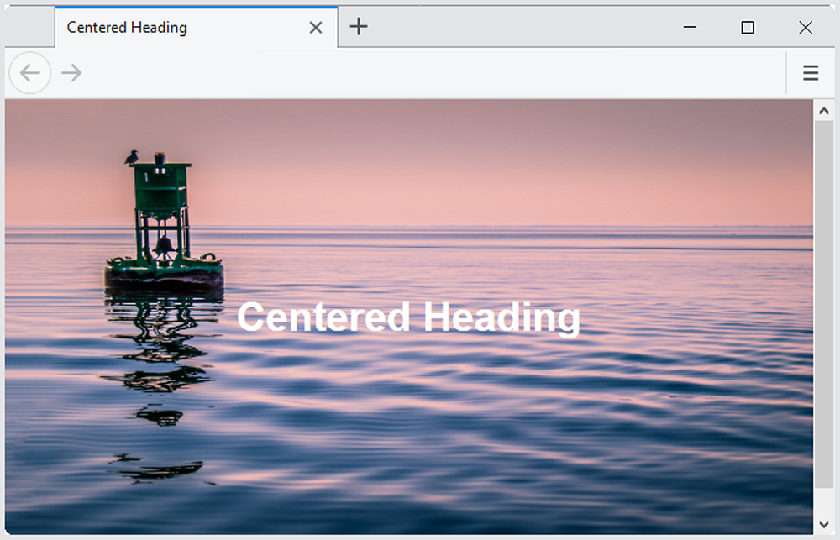
Figure 7.30 Centered text with background image

Slide 31
Progressive Enhancement with Grid
CSS Feature Query
A feature query is a conditional that can be used to test for support of a CSS property, and if support is found, apply the specified style rules.
@supports ( display: grid) {
…. grid styles go here …
}
Progressive Enhancement Strategy
Configure web page layout with normal flow or float for browsers and devices that do not support grid
Configure a feature query with grid layout for modern browsers

Slide 32
Viewport Meta Tag (1 of 2)
Default action for most mobile devices is to zoom out and scale the web page
Viewport Meta Tag
Created as an Apple extension to configure display on mobile devices
Configures width and initial scale of browser viewport
<meta name="viewport" content="width=device-width, initial-scale=1.0">

Slide 33
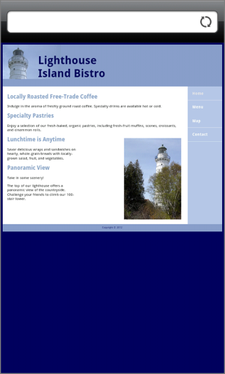
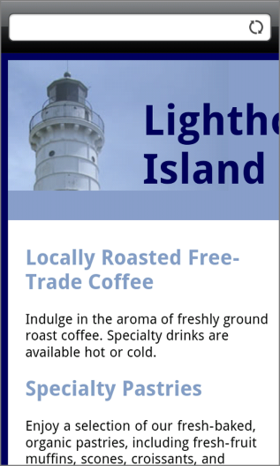
Viewport Meta Tag (2 of 2)
Figure 7.31 Mobile display of a typical desktop web page without the viewport meta tag
Figure 7.32 The viewport meta tag helps with mobile displays

Slide 34
CSS Media Queries
Media Query
Determines the capability of the mobile device, such as screen resolution
Directs the browser to styles configured specifically for those capabilities
Example with link tag
<link href="lighthousemobile.css" rel="stylesheet" media="(max-device-width: 480px)">
Example within CSS
@media (max-width: 768px) {
}

Slide 35
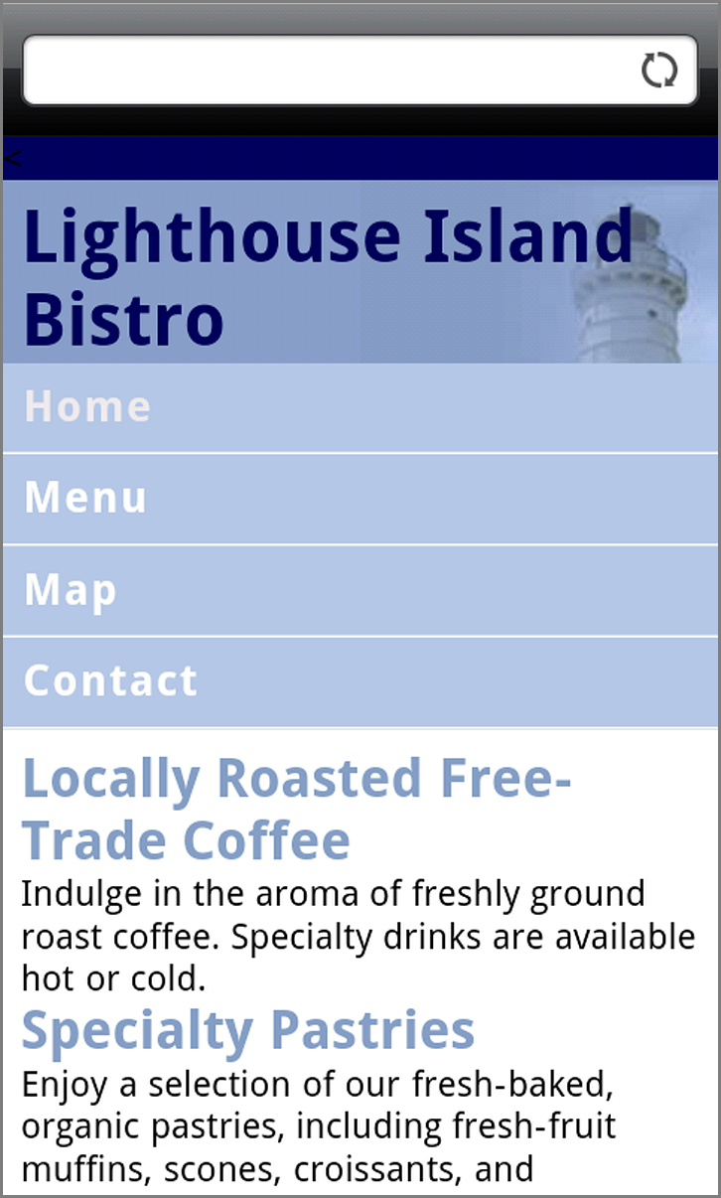
Figure 7.33 CSS media queries help to configure the page for mobile display

Slide 36
Mobile First Approach
Responsive design layout strategy
Term coined by Luke Wroblewski
The Mobile First Process:
Configure a single-column page layout for narrow screens – smartphones! Test with a small browser window if needed.
Resize the browser viewport to be larger until the design “breaks” and needs to be reworked for a pleasing display—this is the point where you may need to code a media query.
Continue resizing the browser viewport to be larger until the design breaks and code additional media queries.

Slide 37
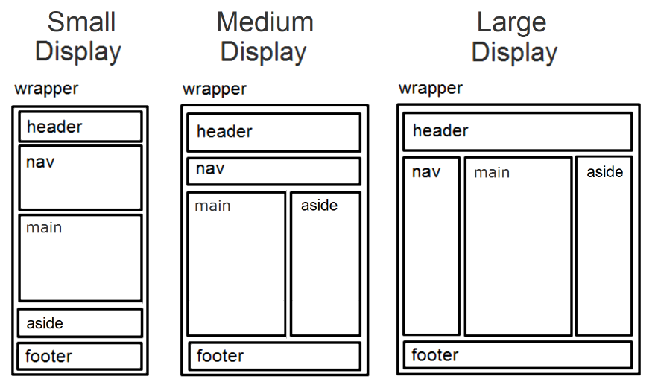
Responsive Layout with Media Queries
Hands-On Practice 7.8
Figure 7.34 Three wireframe layouts

Slide 38
Responsive Grid Layout with Media Queries
Hands-On Practice 7.9
Figure 7.40 Three wireframe layouts

Slide 39
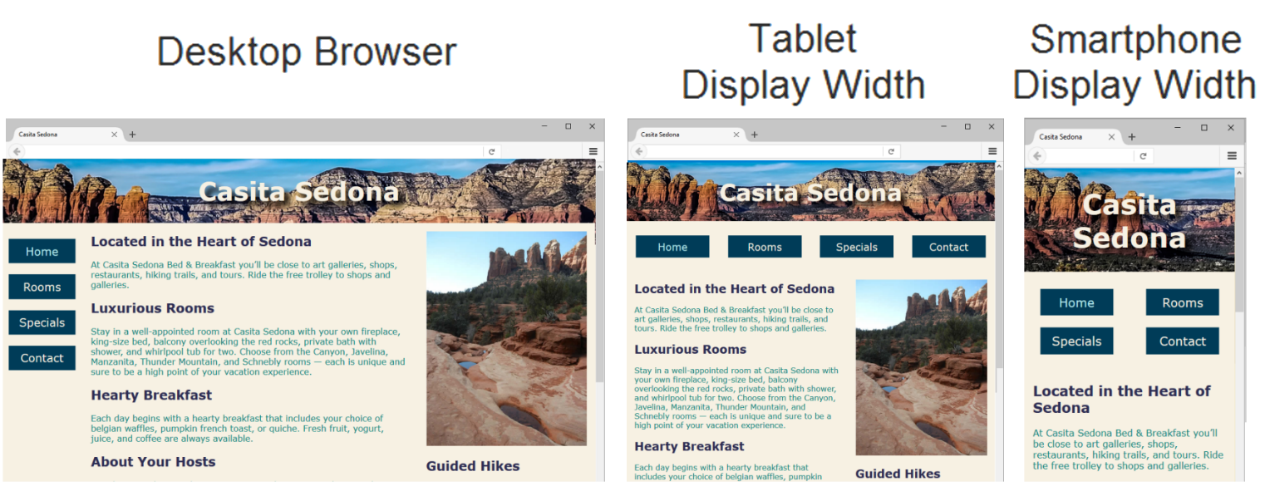
Flexible Images (1 of 2)
Figure 7.47 The web page demonstrates responsive web design techniques

Slide 40
Flexible Images (2 of 2)
Edit HTML: remove height and width attributes
CSS: img { max-width: 100%;
height: auto; }

Slide 41
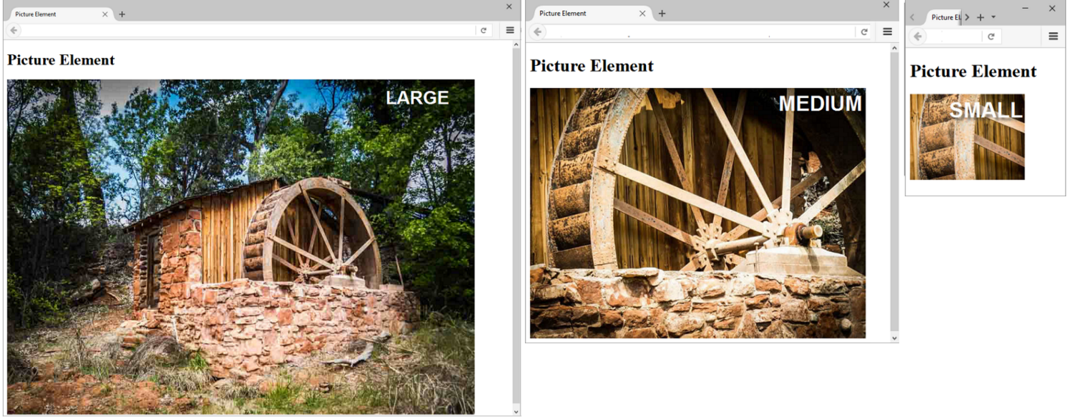
Responsive Images HTML 5.1 Picture Element (1 of 2)
Figure 7.49 Responsive image with the picture element

Slide 42
Responsive Images HTML 5.1 Picture Element (2 of 2)
<picture>
<source media="(min-width: 1200px)" srcset="large.jpg">
<source media="(min-width: 800px)" srcset="medium.jpg">
<source media="(min-width: 320px)" srcset="small.jpg">
<img src="fallback.jpg" alt="waterwheel">
</picture>

Slide 43
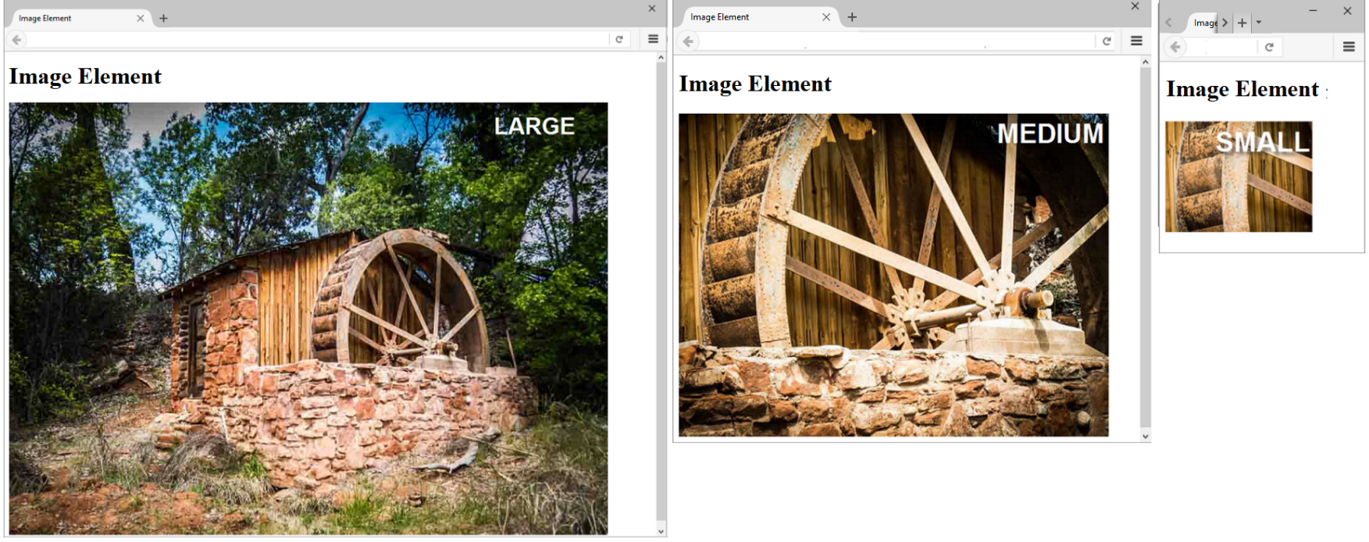
Responsive Images HTML 5.1 sizes & srcset Attributes (1 of 2)
Figure 7.50 Responsive image with the image element’s srcset attribute

Slide 44
Responsive Images HTML 5.1 sizes & srcset Attributes (2 of 2)
<img src="fallback.jpg"
sizes="100vw"
srcset="large.jpg 1200w, medium.jpg 800w, small.jpg 320w"
alt="waterwheel">

Slide 45
Checkpoint (2 of 2)
What is meant by the phrase "Mobile First"?
Are there certain values that must be used in CSS media queries? Why or why not?
Describe coding techniques that will configure an image with a flexible display.

Slide 46
Testing Mobile Display Options
Test with a mobile device
Test with a Desktop Browser
Other Options
Opera Mobile Emulator https://dev.opera.com/articles/opera-mobile-emulator/
Google Chrome Dev Tools https://developers.google.com/web/tools/chrome-devtools/device-mode/
iPhone Emulator http://www.testiphone.com

Slide 47
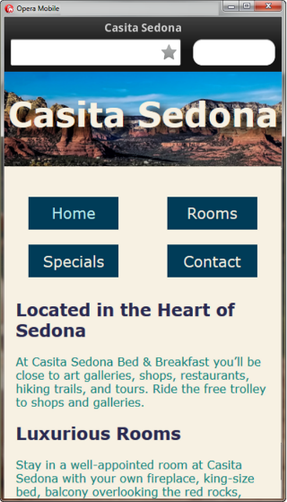
Figure 7.51 Testing a web page with the Opera Mobile Emulator. © Opera Software 1995–2019.

Slide 48
CSS Debugging Tips
Manually check syntax errors
Use W3C CSS Validator to check syntax errors
http://jigsaw.w3.org/css-validator/
Configure temporary background colors
Configure temporary borders
Use CSS comments to find the unexpected
/* the browser ignores this code */
Don’t expect your pages to look exactly the same in all browsers!
Be patient!

Slide 49
Summary
This chapter introduced you to modern layout techniques which configure responsive web pages that display well on desktop browsers and mobile devices.

